Slide 1
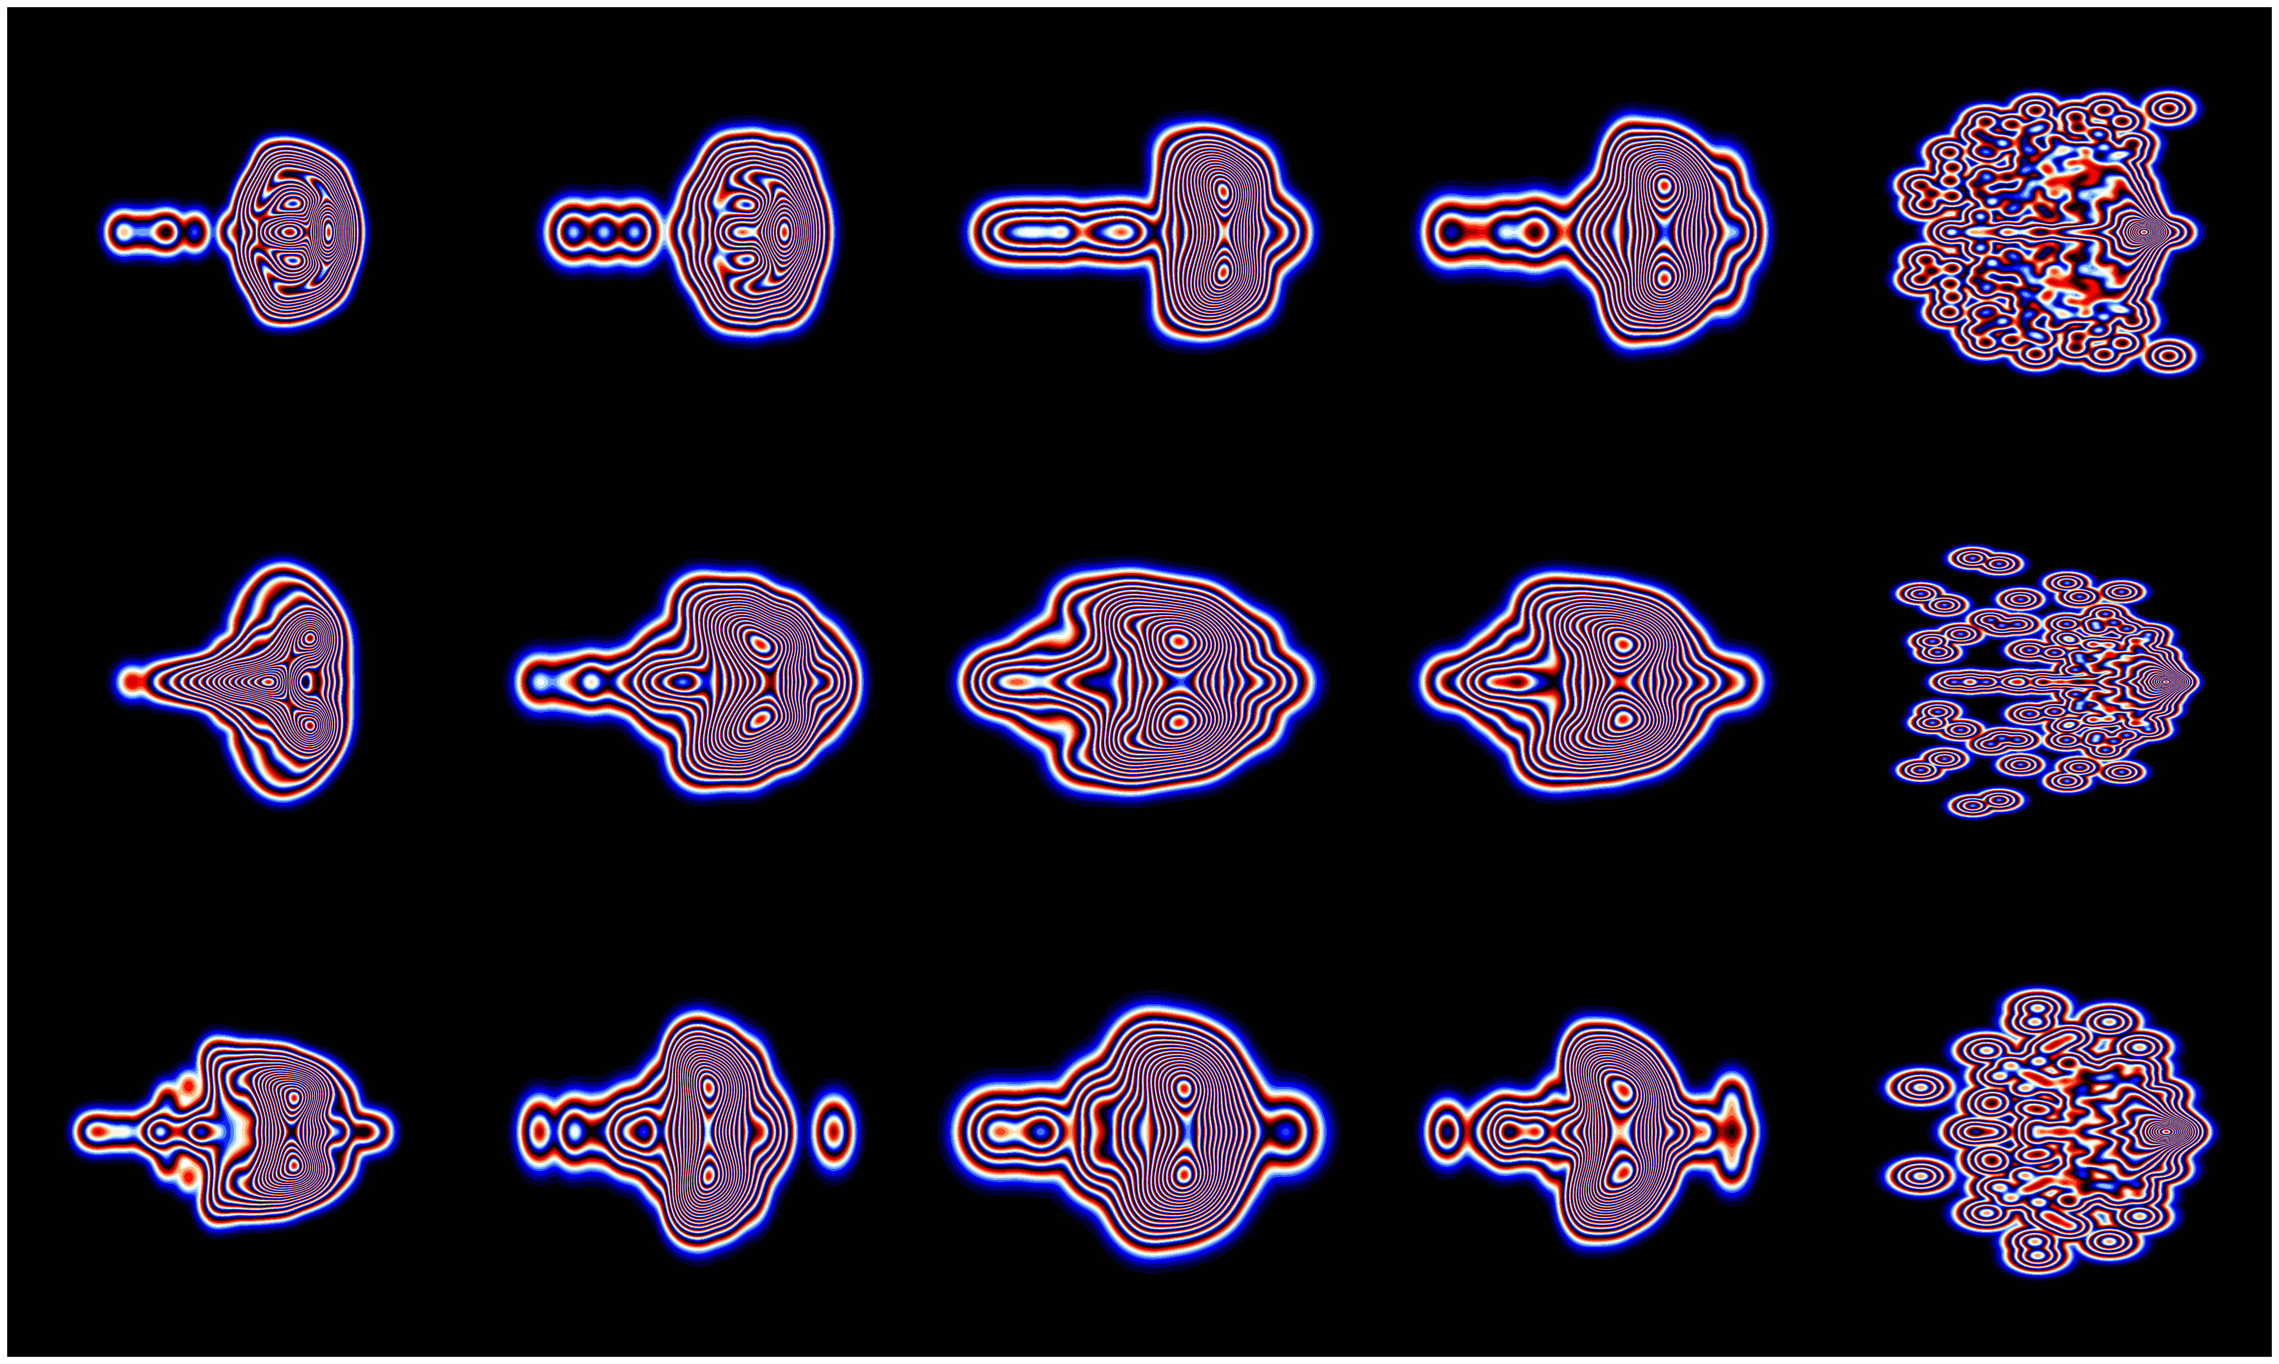
Exploring Eigenvalue Landscapes No.1
This captivating work unveils the intricate eigenspectrum density of the Jacobian matrix, rendered from the finite-volume simulations of 15 distinct combinations of physics, mesh, and boundary conditions. Each arrangement within the 3 by 5 canvas encapsulates a
unique narrative, offering a visual journey through the dynamics of the simulated systems. A discerning eye will note certain configurations exhibiting a discrete bubble, often segregated towards the right or verging on separation, indicative of unstable numerical simulations. Perhaps the most captivating aspect of this artwork lies in its inherent subjectivity; each observer is invited to interpret and uncover their own narrative, enriching the multidimensional tapestry of its meaning.

