Slide 1
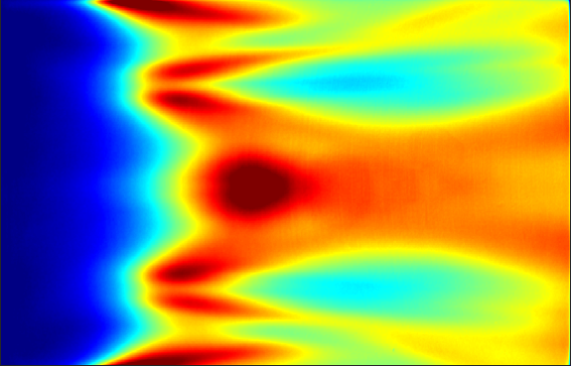
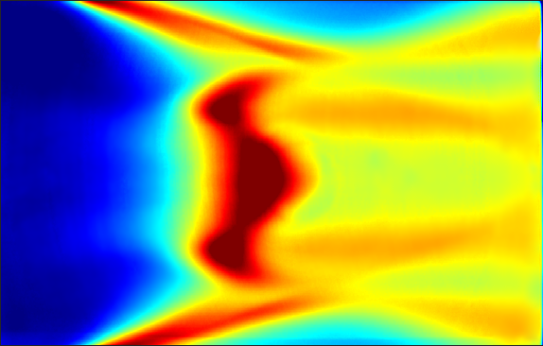
Streaks of heating on a 20º finite-span compression flap in low-noise Mach-6 flow at Reynolds numbers of 6.3 million (left) and 10.7 million (right) per meter on a canonical cone-slice ramp geometry at a 0º angle of attack.
higher heating rates
Dark blue regions on the left are indicative of separated flow due to the convex compression corner formed by the flap. Heating patterns are indicative of strong vortex formation in the separated shear layer which leads to transition.
Red indicates higher heating rates, leading to higher surface temperatures in long-duration flight

Slide 2
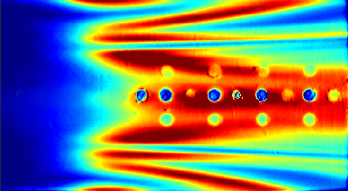
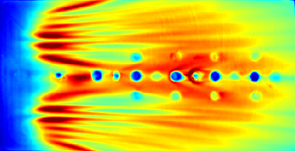
Streaks of heating on a 15º (left) and 20º (right) finite-span compression flap in low-noise Mach-6 flow at a Reynolds number of 6.8 million per meter on a canonical cone-slice-ramp geometry at a 2º angle of attack.
higher heating rates
Heating patterns are indicative of vortex formation in the separated shear layer which leads to transition. At higher vehicle angles of attack and compression angles, these streaks multiply and heating becomes more intense
Light-colored dots are sensors on the model.

