Slide 1
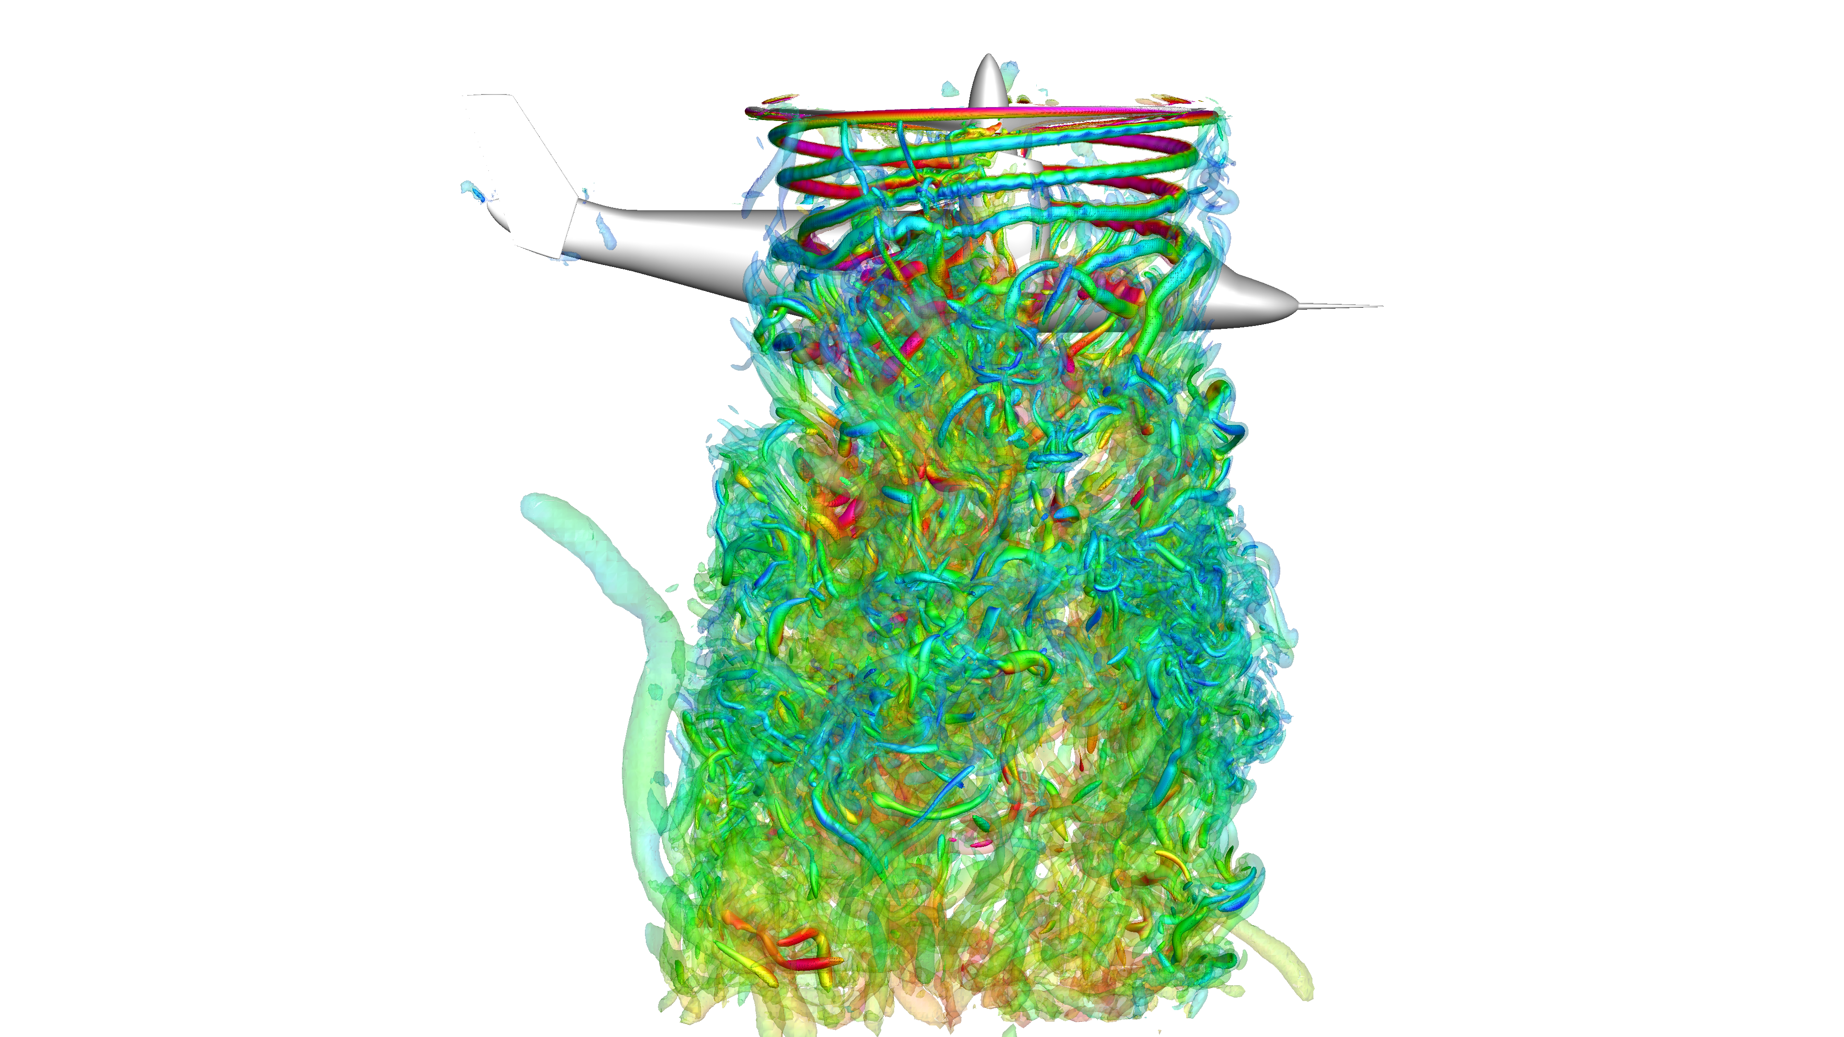
Towards High-Fidelity CFD Simulations of Rotorcraft
To reach the goal of digital certification for eVTOL and traditional rotorcraft vehicles, CFD methods must demonstrate the capability to both consistently reach the accuracy of experimental and/or flight tests, and do so within the time frame and budgetary constraints of a typical engineering company. Towards this goal, we will demonstrate the promising steps advancing the industrial use of high-fidelity CFD methods on complex rotorcraft problems using cloud computing resources and a state-of-the-art CFD solver.

