Slide 1
Town Hall Meeting
11 January 2026

Slide 2
Agenda
Welcome
Council of Directors Updates
Board of Trustees Updates
Institute Status
Q&A

Slide 3
Council of Directors Update
Dan Jensen, Speaker of the Council

Slide 4
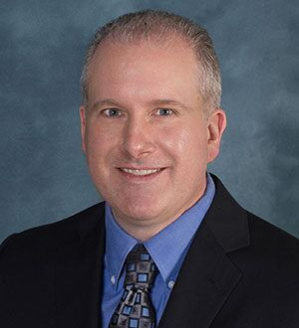
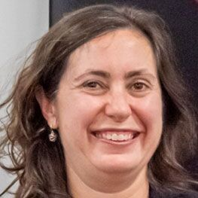
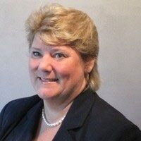
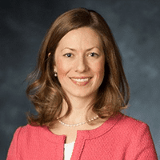
Council of Directors
2025-2026
Daniel Jensen
Speaker
2024-2027
Jeanette Domber
Integration & Outreach Division
Chief, 2025-2028
Jane Hansen
Regional Engagement Activities Division
Chief, 2023-2026
Lesley Weitz
Technical Activities Division
Chief, 2023-2026
Sofia Russi
Aerospace Outreach Group 2025-2028
Gustavo Ordonez
Business & Management Group 2023-2026
Kyle Zittle
Region I
2023-2026
Ryan Sherrill
Region II
2023-2026
Dawn Phillips
Aerospace Design & Structures Group
2024-2027
Martiqua Post
Aerospace Sciences Group
2023-2027
Robert Winn
International Activities Group
2023-2026
Abdollah Khodadoust
Integration Group
2024-2027
Peggy Cornell
Region III
2021-2027
Ellen Gillespie
Region IV
2022-2028
David Maroney
Aircraft Technology, Integration & Operations Group
2023-2026
Michel Ingham
Information Systems Group
2022-2028
Taylor Fazzini
Young Professionals Group
2025-2026
James Guglielmo
Region V
2022-2028
Oleg Yakimenko
Region VI
2020-2027
Rusty Powell
Propulsion & Energy Group
2022-2028
Stephen Blanchette
Space & Missiles Group
2022-2028
Cees Bill
Region VII
2020-2026

Slide 5
Council Meetings Highlights
New READ Chief, Jim Guglielmo, to begin term in May
New TAD Chief, Rick Mange, to begin term in May
General Election
2026 Council of Directors Election voting opens 26 January – 20 February
2027 Council of Directors open positions will be announced in May
Region VII Student Conference received a 20% increase in papers over last year
Regional Leadership Conference will be held on Tuesday – all are welcome
Fluid Instabilities and Transition Technical Committee chartered
IOD Membership Survey launched and closed
Advanced Air Mobility (AAM) Multimodal Working Group progressing toward IOC
Notes:
2026 Positions:
READ - Chief
READ - Region 1
READ - Region 2
READ - Region 7
TAD - Chief
TAD - Aircraft Technology Integration & Operations
TAD - Space & Missiles
IOD - Business & Management
IOD - International Activities
IOD - Young Professionals
2027 Positions:
Speaker
READ - Region 3
READ - Region 6
TAD - Aerospace Design and Structures
TAD - Aerospace Sciences

Slide 6
Board of Trustees Update
Dan Hastings, President

Slide 7
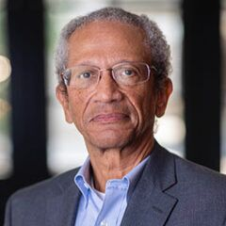
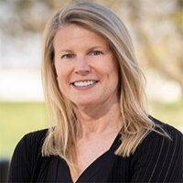

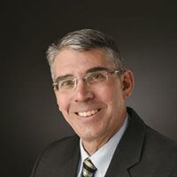
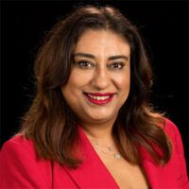
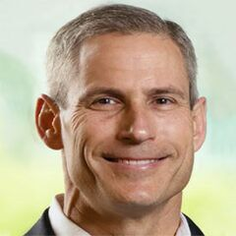
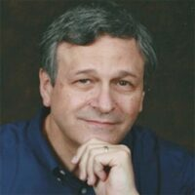
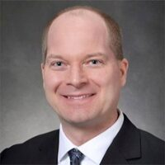
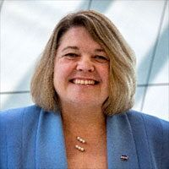
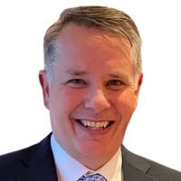
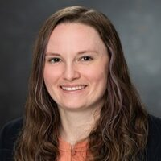
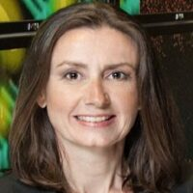
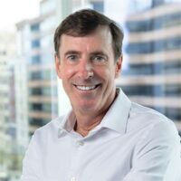
Board of Trustees
2025-2026
Daniel Hastings President, 2024-2026
Nancy Andersen
Trustee, 2024-2027
Johnathon Caldwell
Trustee, 2023-2026
Michael Gazarik
Trustee, 2025-2028
Tina Ghatore
Trustee, 2025-2028
Dana “Keoki” Jackson
President-elect,
2025-2026
R. Steven Justice
Treasurer, 2024-2027
Ben Linder
Trustee, 2024-2026
Jill Marlowe
Trustee, 2025-2028
Todd Mosher
Trustee, 2021-2027
Cheryl O’Keefe
Trustee, 2024-2027
Karen Willcox
Trustee, 2020-2026
Clay Mowry
Secretary (ex officio)
7

Slide 8
Board of Trustees Election
Election for the Three At-Large positions will be held at the Council of Directors Meeting on 14 January 2026
Election for the Treasurer-Elect position will be held at the Board of Trustees Meeting on 6 February 2026
New terms will begin at the end of the
Spring Business Meeting

Slide 9
Voting Rights Extension
Board policy updated in November states:
“All individual members paying the professional or premium dues rate, in effect at the time, whether they are eligible for a discount or not and regardless of whether the dues are paid by another party on the individual’s behalf, such as an employer, corporate member, or other party, shall be eligible to vote in any election open to the general membership including constitutional amendments, the office of President-elect, and elected members of the Council of Directors regardless of the individual’s membership grade commencing with the 2026-27 election cycle.”
FY25 Eligible Votership Breakdown

Slide 10
Board-Directed Committee Term Limits
Board of Trustees and Council of Directors approved a bylaw change that imposed term limits on the chairs (two 3-year terms) and at-large members (six 1-year terms).
To ease transitions, some waivers were granted, upon request.
The affected committees are:
- Committee on Higher Education - Ethics Committee
- Honors and Awards Committee - Public Policy Committee
- Publications Committee - Standards Steering Committees

Slide 11
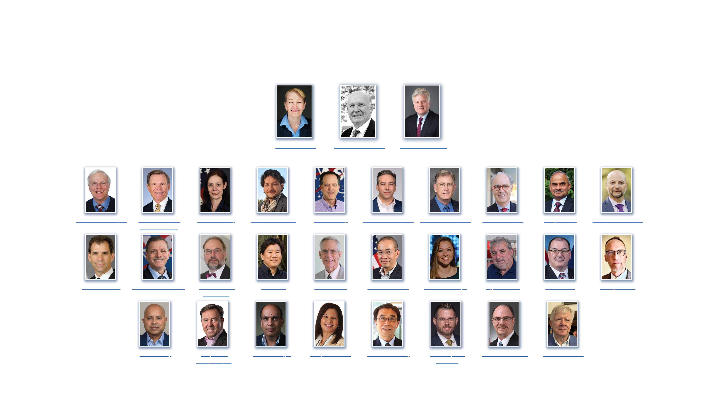
2026 Honorary Fellows and Fellows

Slide 12
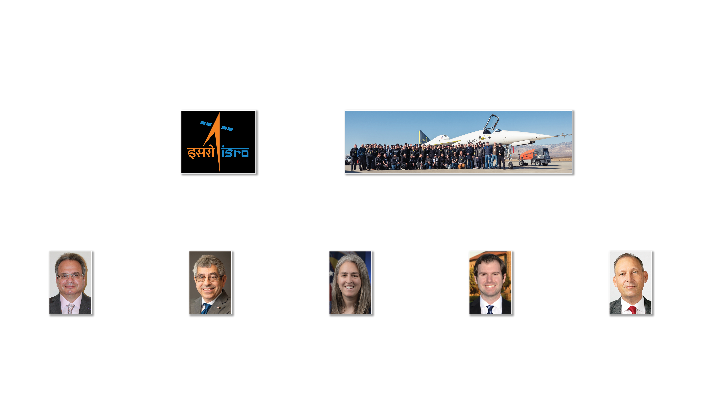
2026 Premier Award Recipients

Slide 13
Institute Update
Clay Mowry, CEO

Slide 14
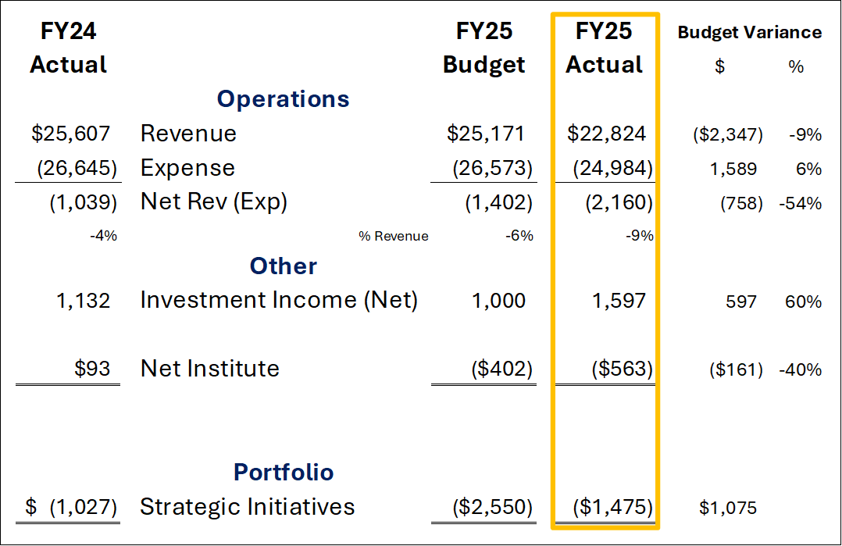
Institute Financials FY25 (000s)
Notes:
FY25 Revenues finished 9% below budget; the variance to budget is due to lower revenue from the co-located Aviation and ASCEND. Without AVAS, revenues ended FY25 2% below budget.
FY25 Expenses ended 6% below budget as AIAA managed expenses.
The standard reporting slide has been update to include net investment income (interest, dividends and realized gains). Investment income grew 41% over FY24!
The standard reporting slide has been updated to include report of Strategic Investment spending. FY25 SI spending was under budget.

Slide 15
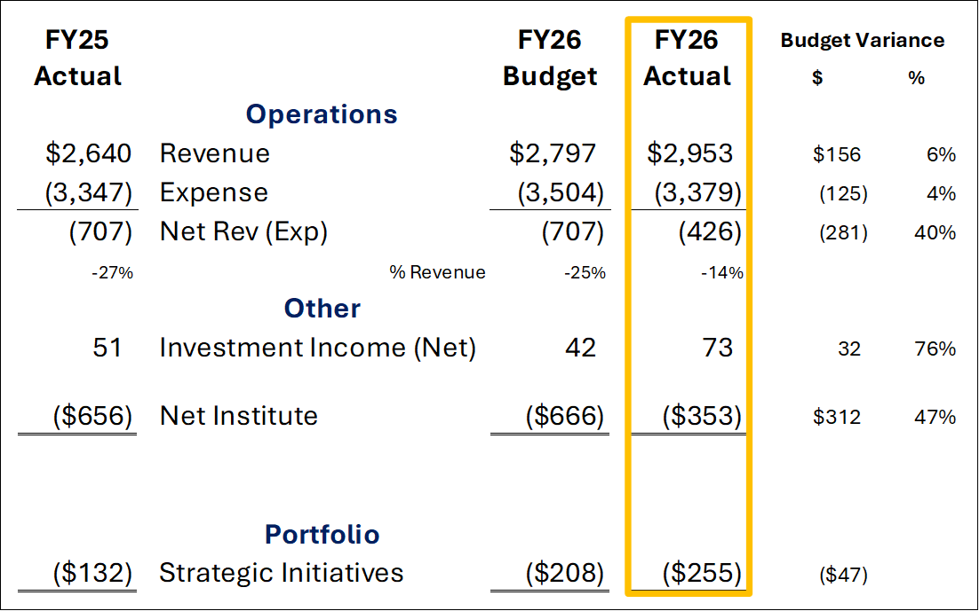
Institute Financials FY26Nov (000s)
Notes:
FY26 Budget was approved by the BOT last Sept. Though early in the FY, the first 2 months of FY26 are better than budget and the prior year for revenue, expenses, and investment income. We are on track and off to a solid start.

Slide 16
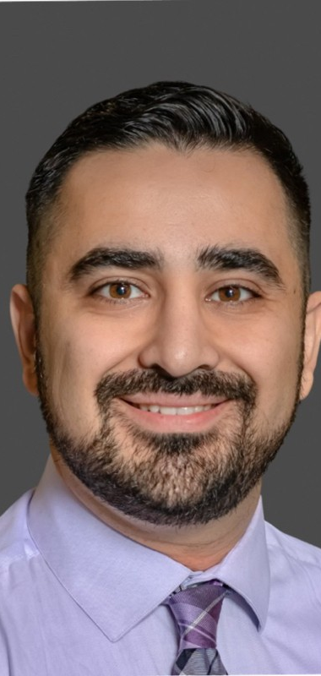

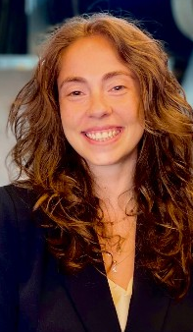
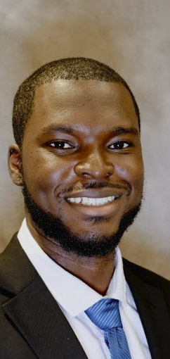
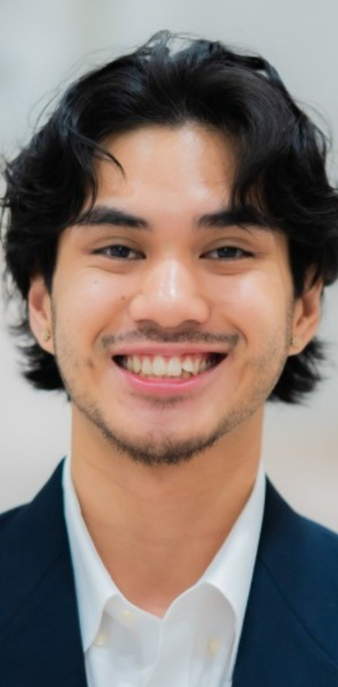
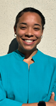
Welcome New Staff
Kian Manafi
Social Media Manager
11/04/2025
Ben McRae
Senior Web Developer
11/17/2025
Martina Bruno
Senior Manager, Europe, Middle East, and Africa (EMEA)
11/24/2025
Zafir Alolade
Member Engagement Intern
10/02/2025
Branden Tirona
Events Intern
11/11/2025
Carla Soto
University Relations Manager
1/12/2026

Slide 17





AIAA 2026: What’s Ahead
AIAA
HQ Move
Notes:
Changing Membership Model – Expanding our reach and impact
Enhancing Aerospace America 2025 Year in Review – Digital version launched this week
Celebrating 30 Years of the AIAA Foundation – Through impact and special fundraising campaigns
Planning executive visits to Germany, Italy (January) and UK (June)
Technologies Transforming Aerospace – (Release in February)
AIAA + BryceTech | 600+ technical leaders surveyed (100+ CTO-level)
Outlook on the next 20 years of aerospace technology
Commemorating Goddard 100th Anniversary (March)
Cross-industry collaboration
100 Years of Modern Rocketry collection, led by Dr. Vigor Yang & Dr. Joseph Powers
National Rocket Launch participation
Re-envisioning ASCEND (May)
New home in Washington, D.C.
Critical engagement with partners & NASA Administrator Isaacman
Moving AIAA headquarters (June/July)

Slide 18
Celebration through impact awareness
$30 for 30 years fundraising campaign
Silent Auction in SciTech exhibit hall

Slide 19
Technologies Transforming Aerospace -Comprehensive forecast AIAA + Bryce Tech
In depth outlook on the next 20 years of aerospace technology
Responses from 600+ technical leaders (across AIAA Technical Community)
Feb 2026 Release

Slide 20
2026 Goddard Astronautics Award presented to TEAM ISRO for the success of Chandrayaan-3 soft landing on the lunar south pole region
Cultivating Goddard/Rocket technical papers for ARC showcase
Participating in national rocket launch day, March 16
Grassroots launches for all ages and abilities – #Goddard100Launch
Sponsoring First Launch Centennial Event, in Hanover, MA, March 16
Dan Hastings will be a keynote speaker

Slide 21
ASCEND Update Natalia Larrea Brito

Slide 22

ASCEND
19-21 May 2026, Washington, D.C.
At the Washington Hilton 2026-2028
Lockheed Martin is the ASCEND founding sponsor
Establishing a D.C. Space Week
Multiple event partners delivering high-quality, curated content

Slide 23
ASCEND 2026 | Status overview
Complex event architecture as multiple partners are integrated into a unified program
High-quality submissions received through the Call for Content (CFC)
Author/session organizer notifications issued on 16 December
Conference registration opens on 27 January
Program at full capacity
Call for Content Submissions
Call for Tech. Papers: 234
Call for Sessions: 128

Slide 24








ASCEND 2026 | Event Partners
 | SGx event on Sunday & Monday
 | CSF Space Policy Summit (Tuesday & Wednesday) Spacefarers reception
 | Classified Day in Chantilly, VA (Monday) Space Transformation Summit (Thursday)
 | ISS R&D sessions (Tuesday) ISS R&D Technical presentations (Wednesday & Thursday)
 | Finance & Innovation content (Tuesday & Wednesday) Potentially organizing a start-up pitch competition (TBC)
 | National Security content (Wednesday) Spacepower challenge session
 | Satellite infrastructure and services content (Thursday)
 | ISS Heritage sessions (Thursday)

Slide 25
ASCEND 2026 | Program At-A-Glance
TOTAL CONTENT
~130 Staged Sessions
32 Technical Paper Sessions 191 Technical Papers
6 Workshops / Roundtables
TOTAL ROOMS
4 Stages
6 Technical rooms
1 Workshop room
FORMATS
Plenaries • Panels • Fireside Chats • Workshops • Speed mentoring • Astrodebates • Challenges • Roundtables Social events • …
One program – diverse audiences decision-makers, industry, academia, engineers, researchers, students/YP…

Slide 26





ASCEND 2026 | Program Topics
Call for Content topic areas:
Policy and Law
Some sessions might belong to more than one topic area
Space Economy
Science and Exploration
National Security
(Cross-cutting) Technology Development and Utilization

Slide 27
ASCEND 2026 At-A-Glance
Sunday, May 17
Monday, May 18
Tuesday, May 19
Wednesday, May 20
Thursday, May 21
SGAC SGx event
AIAA Business Meetings – Joint BoT/Council,
TAD, READ, IOD
––––––––
Evening SGAC Dinner
SGAC SGx event
Classified Day at Aerospace Corp,
Chantilly, VA
Artemis Dialogue Mtg, TBC
––––––––
Evening Fellows Dinner
Opening Plenary: NASA Keynote, TBC
CSF Policy Summit, ISS R&D content, BryceTech Investment content, CFC Staged content and tech sessions (across topics inc. space exploration)
––––––––
Evening Expo Hall Reception
Plenary: National Security
CSF Policy Summit, BryceTech Innovators content, CFC content and tech sessions (across topics), ISS R&D tech sessions Start-up pitch competition
––––––––
Networking lunch
––––––––
Evening Spacefarers Reception
Speakers/Sponsors
Reception/CM Reception
Plenary: Intl. Space Agencies panel
Aerospace STS Summit, Novaspace infr. and services content, Smithsonian Air & Space Museum ISS Heritage sessions, CFC content and tech sessions (across topics), ISS R&D tech sessions

Slide 28

Interlocking Orbits—Civilian, Commercial, and Defense
Keynote speakers from NASA, U.S. Space Force
Sessions include:
NASA Space Operations Mission Directorate
Challenges and Opportunities in Commercial LEO Destinations
Shaping the Next Decade of Human Spaceflight
Transport & Support Systems for Exploration
Human Readiness
Integrated Mission Planning
Texas as a Strategic Space Hub

Slide 29





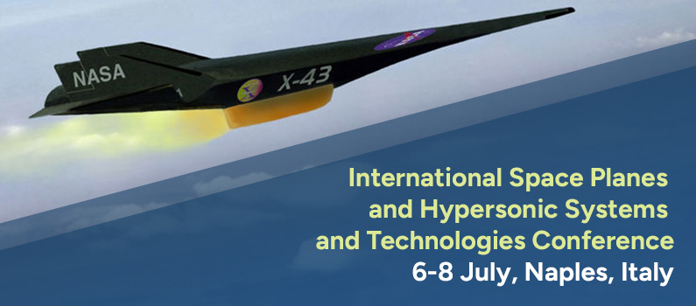

Upcoming Forums and Events
Experimental Sounding Rocket Association (ESRA)
International Rocket Engineering Competition (IREC)
15 – 20 June 2026 | Midland, Texas

Slide 30
Upcoming Student Conferences
Region VI 21-22 March 2026 – California Polytechnic State University San Luis Obispo | Region IV 27-29 March 2026 – Rice University | Region I 12-13 April 2026 – University of Maryland College Park
Region III 10-11 April 2026 – University of Michigan | Region II 26-27 March 2026 – University of South Carolina | Region V 26-27 March 2026 – Iowa State University

Slide 31
Next Virtual Town Hall Meeting 18 February 2026 12 – 1 p.m.

