Slide 1
AIAA Template Quick Guide
Font: Always use Tenorite. This is our standard font and requires no downloads.
Text Sizes:
60 pt: Presentation Title
44 pt: Slide Headers & Pull Quotes
28 pt: Standard Body Text
16 pt / 14 pt: Infographic Titles & Text

Slide 2
Slide Sections
This template contains 7 sections
01. Title: Always the first slide.
02. Main Content: Use for text, images, or Tables (use "Blank" layout for tables or when you have 1 picture ).
03. Dividers: Use to separate topics; follow theme color order.
04. Quotes: Keep font size at 44 pt follow theme color order.
05. Special Slides: For special use cases, recommended only for those more comfortable editing Power Point.
06. Gallery: For showcasing multiple images
07. Closing: Always the final slide.

Slide 5


Slide 6



Meet our Speakers

Slide 7



Meet our Speakers

Slide 18



Slide 19

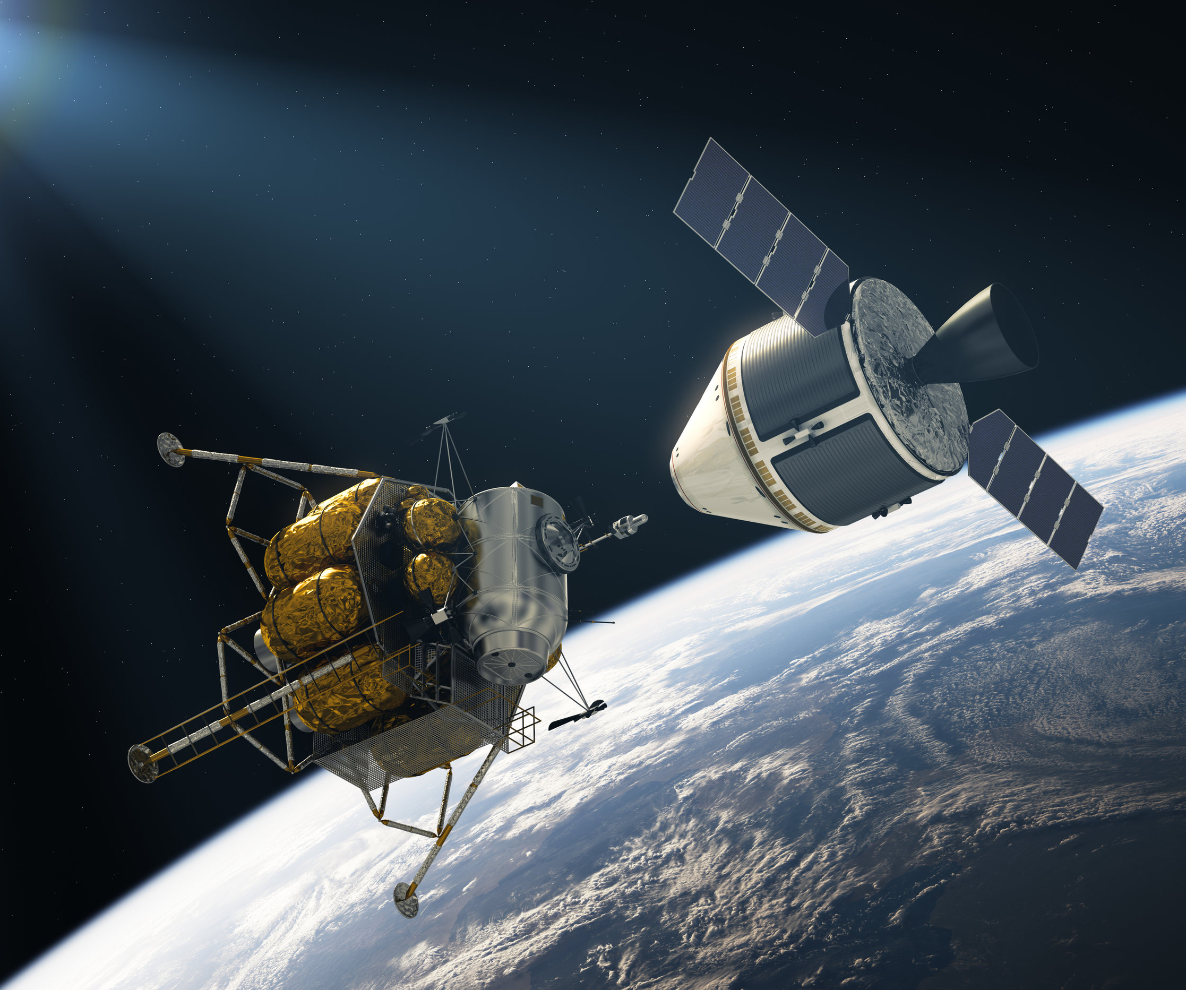
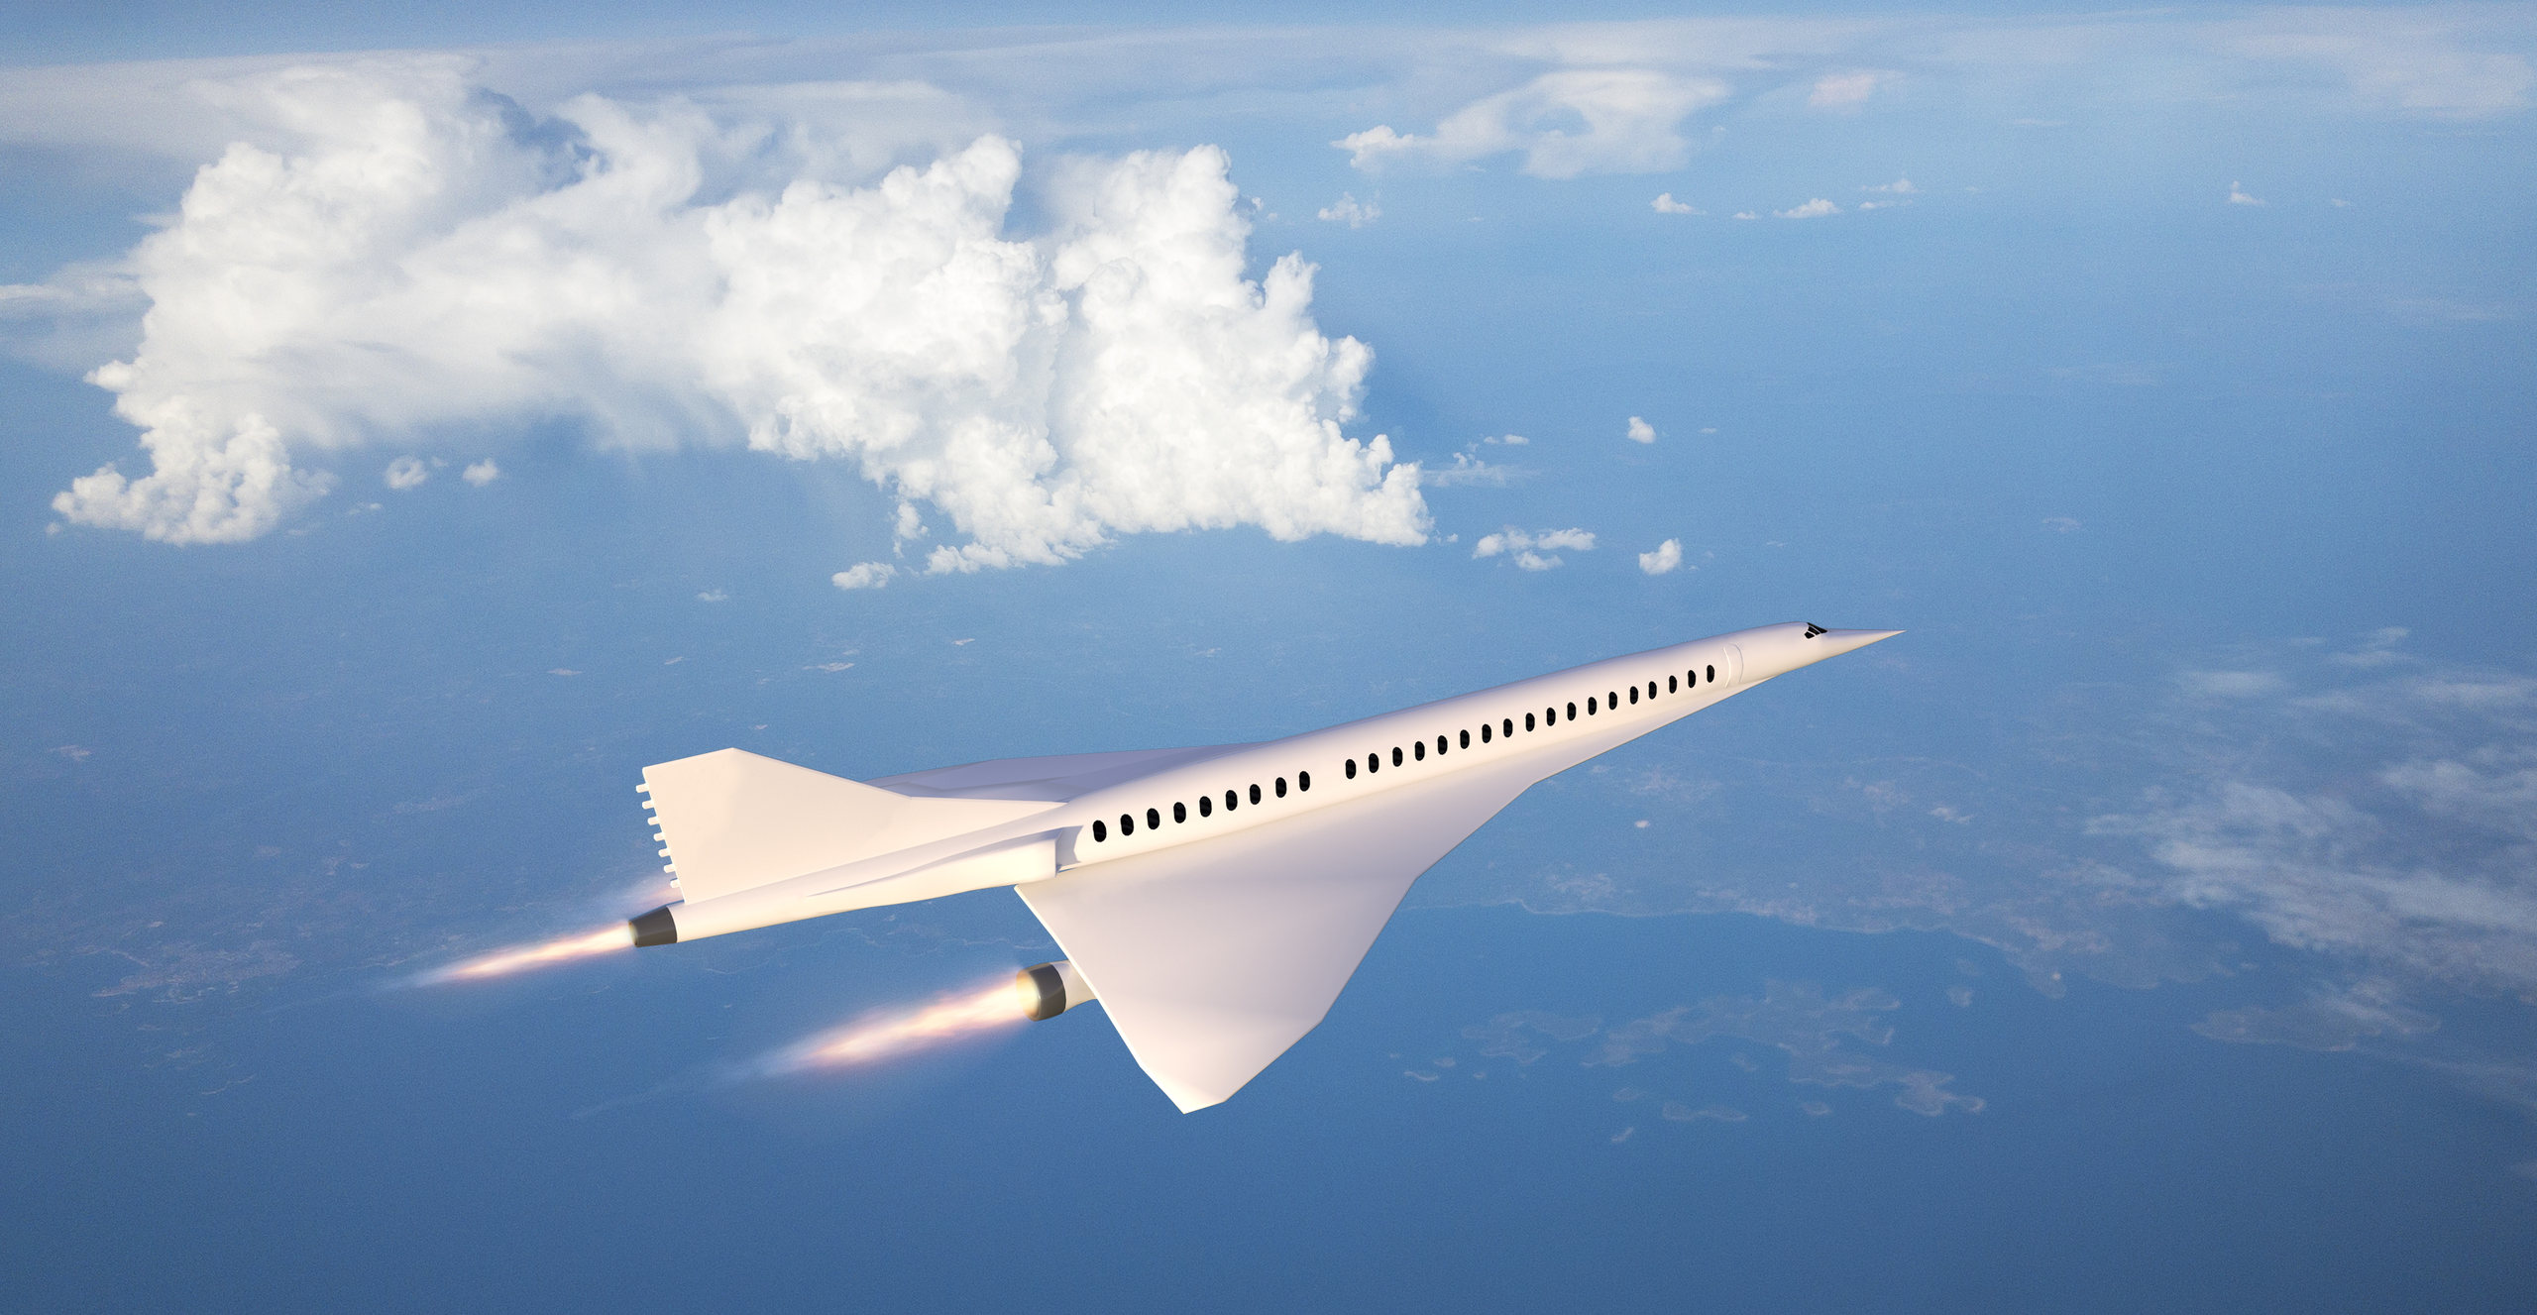




Slide 20






Slide 21


